Slide 1
Team Turtle

Slide 2
Story

Slide 3
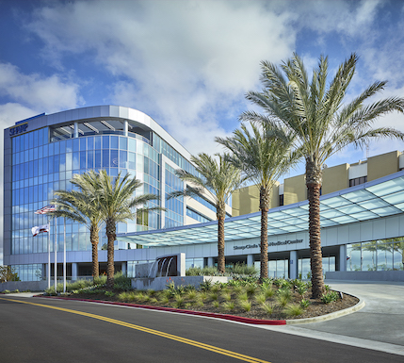
The Challenge
As our city grows and people from all over the world move into our great communities, the challenge of communicating becomes clear. In patientcare this challenge is a common experience here in San Diego.
This is a problem for Hospitals, Clinics, and Pharmacies.

Slide 4
Top Languages in San Diego County
Language: % Population: % non-English: # non-English:
Spanish 24.2% 8.3% 258,812
Tagalog 2.8% 1.0% 31,182
Chinese 1.6% 0.8% 24,945
Vietnamese 1.3% 0.8% 24,945
Pacific Island Languages 1.6% 0.4% 12,473
Indo-European Languages 1.9% 0.5% 15,591
*Total San Diego Population: 3,118,216

Slide 5
Solution
Include: who does it help?

Slide 6
Implementation Models.
Mobile App
Kiosk mode
Provides Care Unit with Patient data
Provides outpatient documents
Scanning features
Vocal/ Text Translation to Vocal/ Text
Tablet Device
Built with Security in mind:
Memory Encryption
Communication Encryption to Care Unit's Infrastructure
Houses Mobile App
Cost

Slide 7
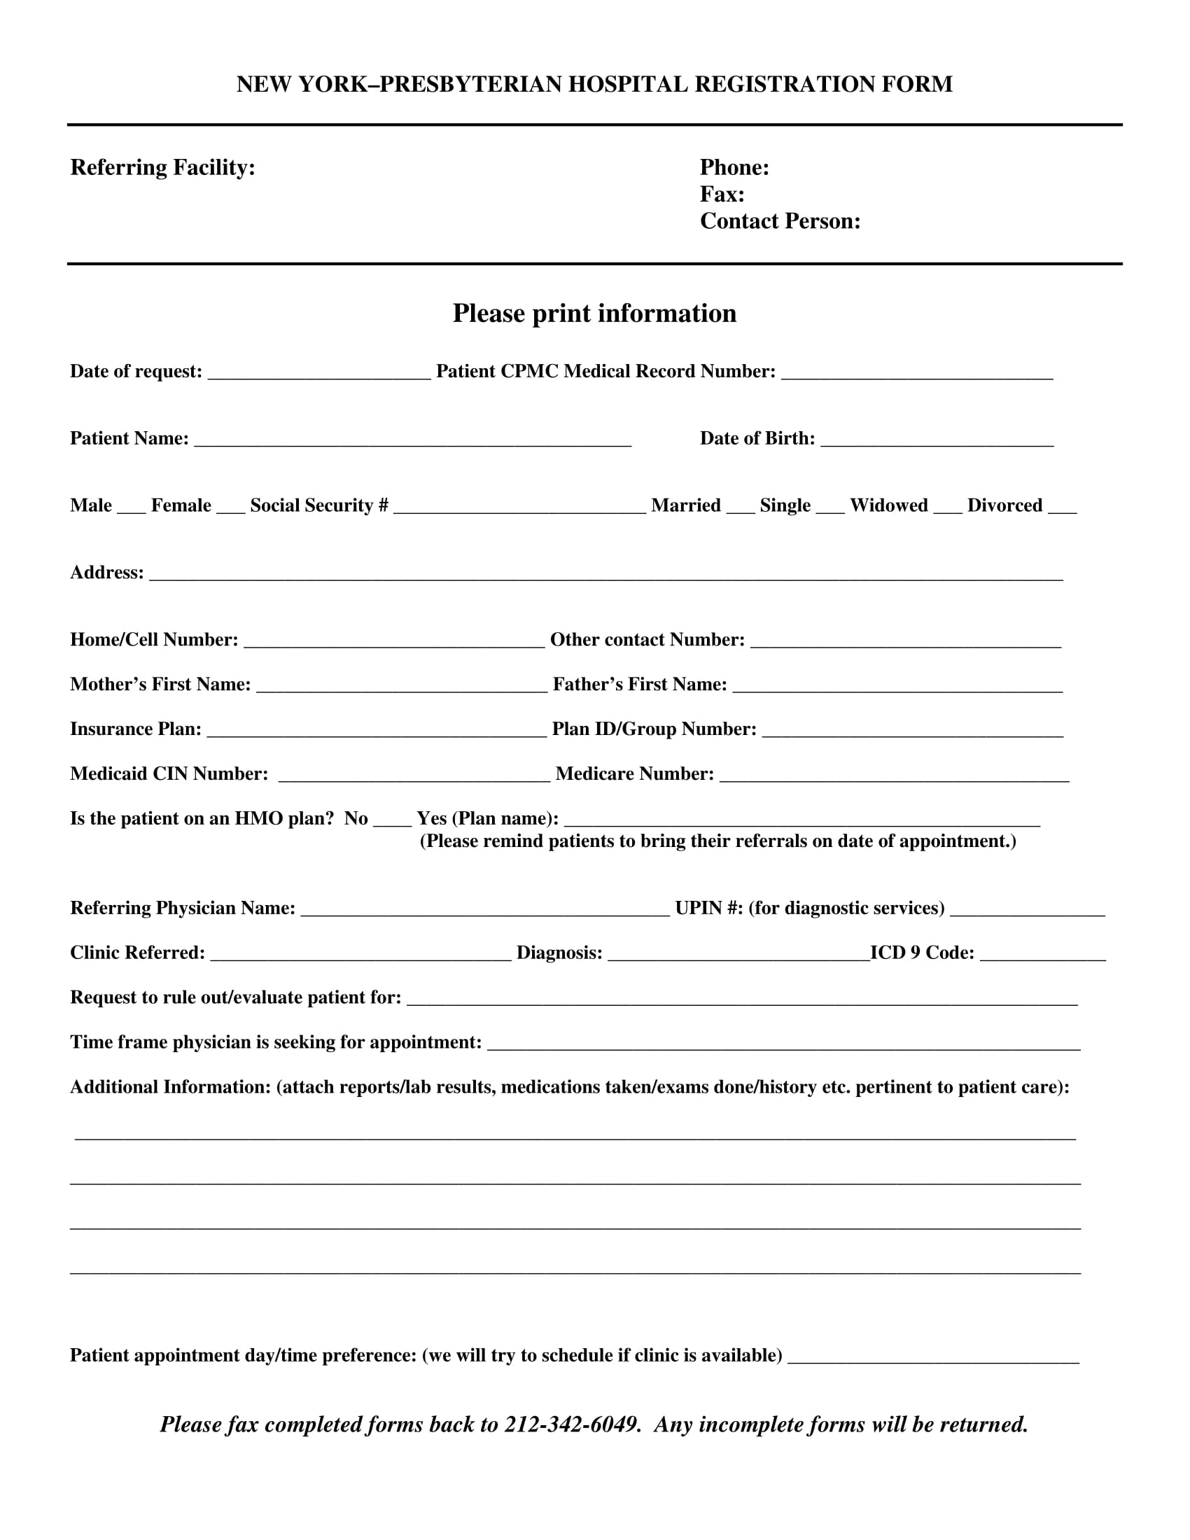
Use Cases
Patient check-in
Kisok or mobile app, gives the option of changing the language on check-in forms
Utilizing the Google Translate API to convert the forum into English for the medical center
It is then uploaded to a pre-existing database used by medical professions

Slide 8
Application Usages Cont.
The Patient Room
Help facilitate communication between healthcare workers and patient.
Giving the patient confidence that they understand what their care requires.
our application would be installed on a mobile or PC available to health workers.
The application would translate and output both audio and text.
Conversational data would be saved to patient file

Slide 9
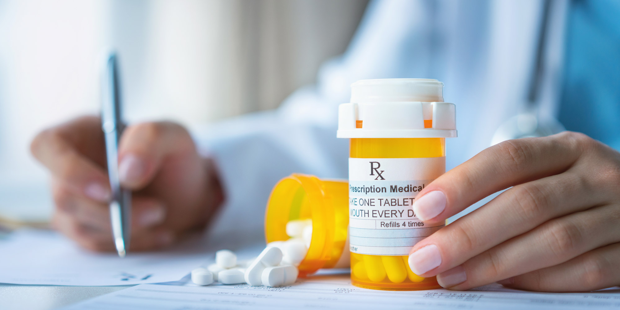
Pharmacy
Translate and print proper medication labels
Clear communication between pharmacist and patient
Ensures patients understanding of medication instructions

Slide 10
Impact
Breaking the Language Barriers
Increase patient care from disenfranchised communities
Better protection for patient's PII data
Increase patient satisfaction

Slide 11
Readiness of the idea to go to market
Current developments in Tech

Slide 12
Resources
Google Translate API
https://cloud.google.com/translate/docs/reference/api-overview
Google API cost
https://cloud.google.com/support/billing
Azure Form Recognizer API
https://learn.microsoft.com/en-us/azure/applied-ai-services/form-recognizer/
San Diego County HHS
https://www.sandiegocounty.gov/content/sdc/hhsa/programs/phs/community_health_statistics/regional-community-data.html
City Demographics
https://public.tableau.com/app/profile/chsu/viz/2020CityDemographicProfiles/Introduction?publish=yes

